Slide 1
Module 1
WebDev 101

Slide 2
Goals
Plan, build, and deploy a static website and a game without backend infrastructure.

Slide 3
Learning Objectives
Coding
Project
Team
Understand and apply correctly the fundamental concepts of WebDev
Combine the basic WebDev technologies correctly, applying the best practices
Be comfortable with the coding, debugging and support tools
Solve problems independently, asking structured and informed questions
Read and write technical documentation
Visualise, plan, prioritise, and manage the scope and tasks of a project
Work in a shared codebase and shared knowledge environment
Communicate blockers effectively
Present your own work to others

Slide 4
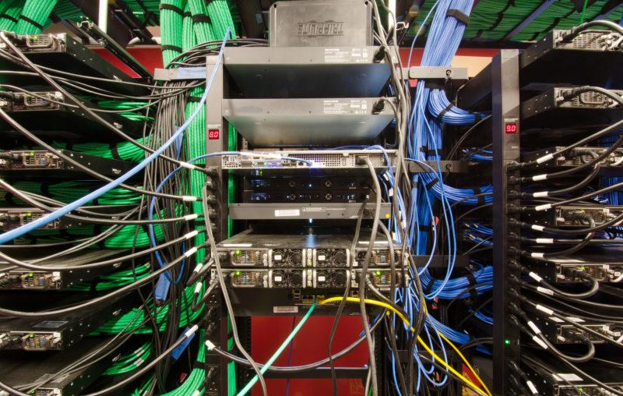
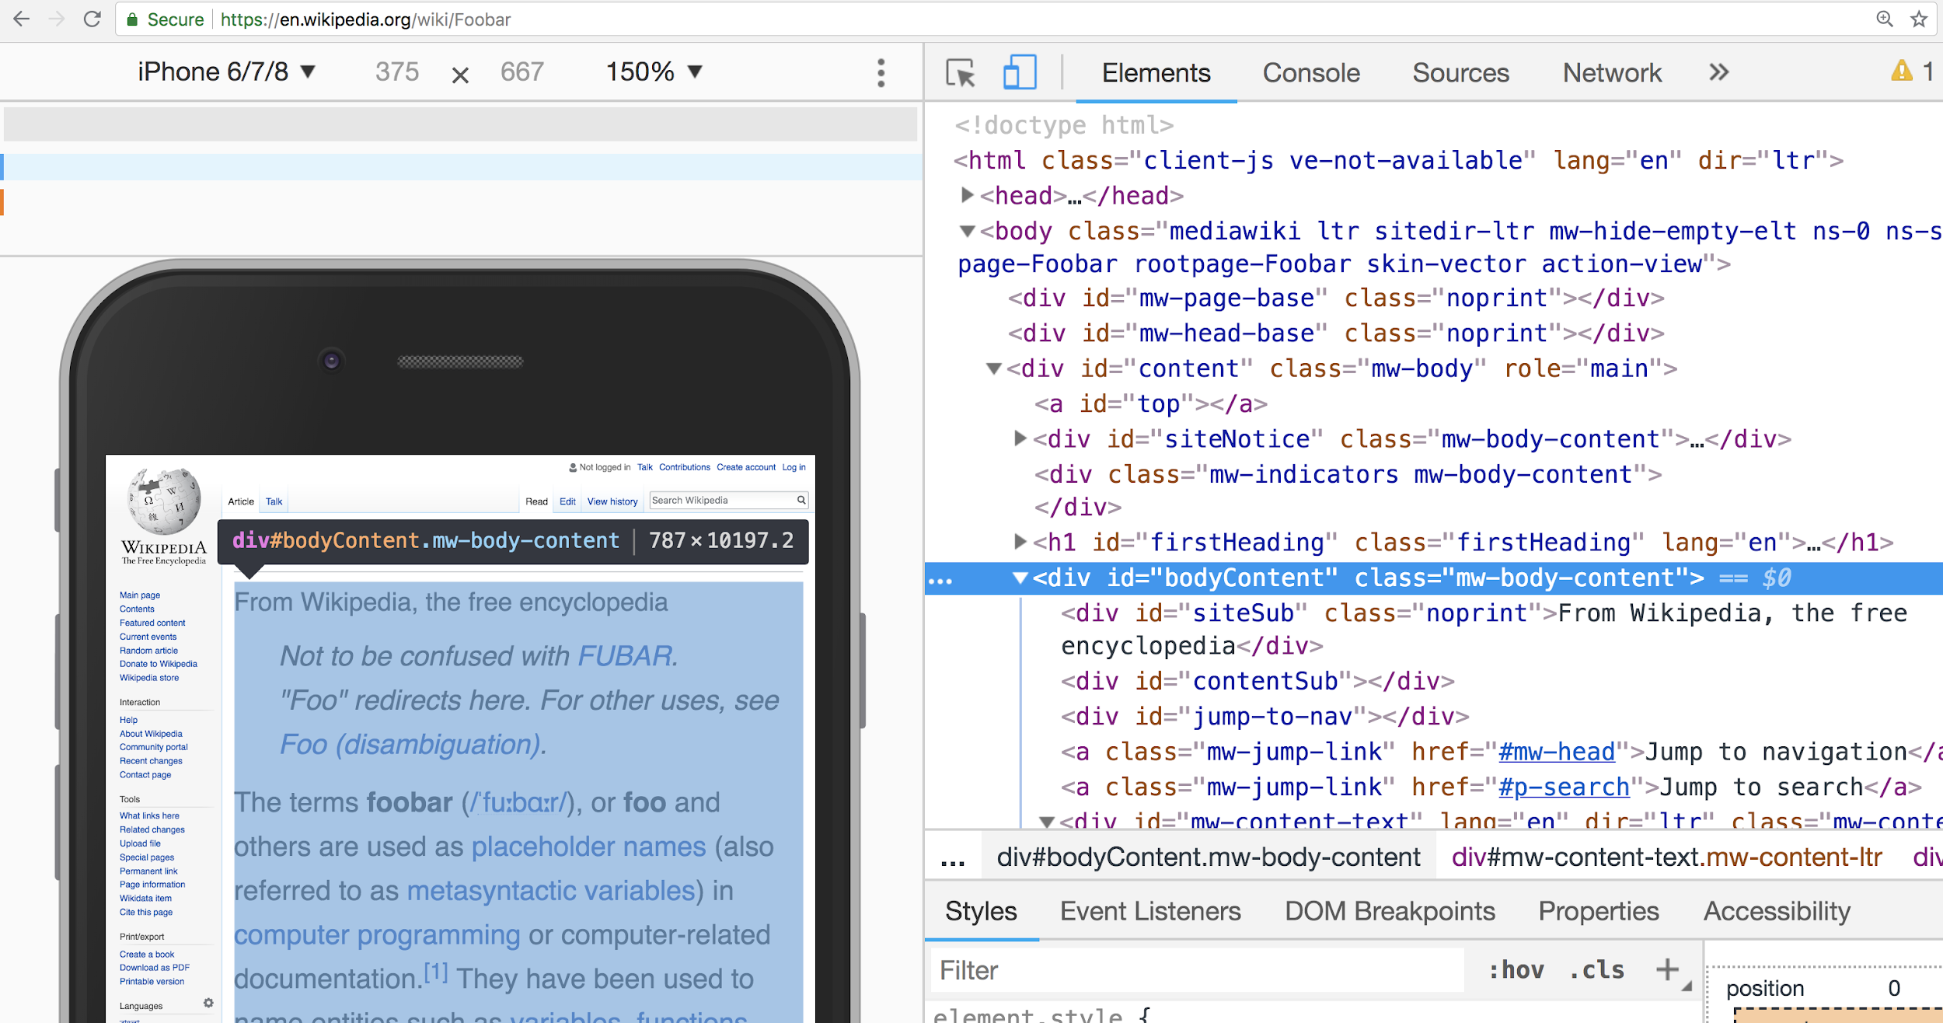

Overview
The Server
The browser
The Internet
HTML
Runtime Engine
APIs - DOM API - Events API - Canvas API
User Agent
CSS
JS
Static Website
CSS
JS
CSS
JS
JS
JS
JS
Debugging
CSS
Developer Tools
CSS
CSS
Behaviour
HTML
Presentation
Structure & Content

Slide 5
Technologies
HTML
CSS
Javascript
Browser APIs :
- DOM API
- Events API
- Canvas API

Slide 6
Tools
Browser Developer Tools
Debugger
IDE
Linter
Terminal
Git + Github + Github Pages
Tests

Slide 7
Concepts
Static Website
Structure & Content + Presentation + Behaviour
Programming + Runtime
Debugging
Events + Async
OOP + Inheritance
APIs

Slide 8
Best Practices
Agile / Lean
XP / Clean Code
Frontend Development

Slide 9
Agile / Lean
Small plans
MVP (Minimum Viable Product)
Visualise work
Limit WIP (work in progress)
Deliver early, deliver often

Slide 10
XP / Clean Code
Pair programming
Coding standards
Single responsibility
Simplicity
DRY + YAGNI

Slide 11
WebDev 101
Structure and content first
Separation of concerns
Semantics & Accessibility
Responsive design > mobile first + fluid layout

Slide 12
Values & Principles
Communication
Rapid feedback
Simplicity
Small increments
Quality work

